Slide 1
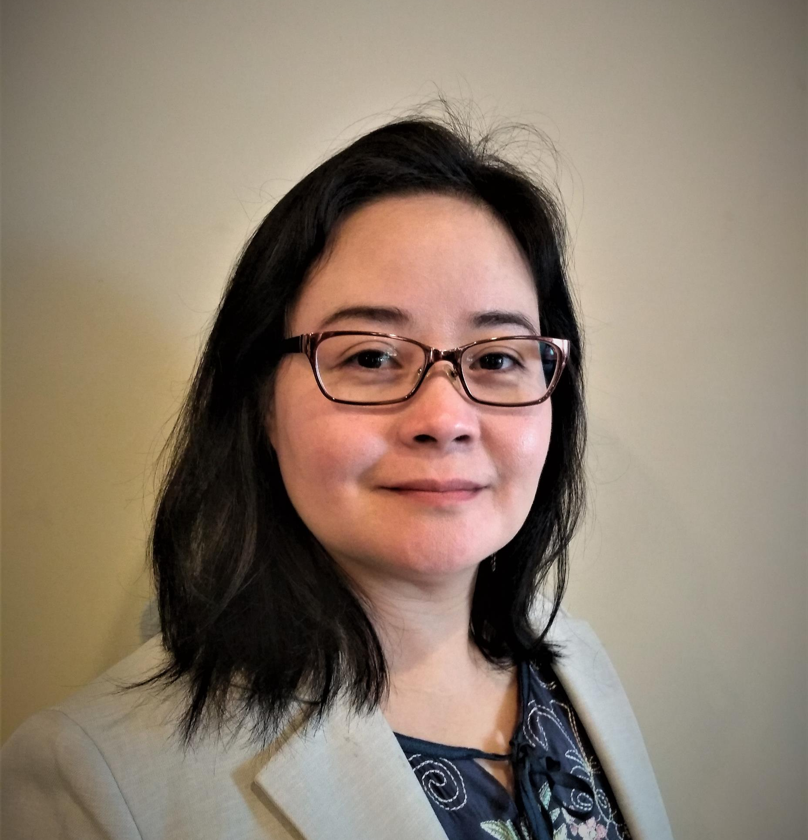
Nashville Davidson County Traffic Accidents 2015 – 2019
Presented by
Christina Hmun NSS Data Analytic Cohort 2

Slide 2
Yearly, Monthly, Daily Traffic Crash
Hit and Run, Property Damage involved
Number of Injury and Fatality

